Slide 1
RapidEye - A Neural Network Based System for Real Time Analysis of Video Footage
Supervised By
Dr. Ahmedul Kabir
Associate Professor
IIT, University of Dhaka
Presented By
Mohammad Momenuzzaman
BSSE 1227
IIT, University of Dhaka

Slide 2

RapidEye
Realtime video Analysis
ML Powered Detection
Intelligent Alerts
Support for multiple video sources

Slide 3
Motivation
Manual System Limitations
Traditional monitoring systems struggle with the increasing volume and complexity of video data, leading to missed incidents and delayed responses.
Need for real-time detection
Critical events require immediate detection and response, which human operators cannot consistently provide across multiple video streams
Enhanced Decision Making
Automated analysis and alerts enable faster, more informed decisions in emergency response and security operations

Slide 4
Quality Function Deployment
Normal Requirements
Video Processing: Process real-time and recorded video streams
Movement Detection: Track and analyze human movements
Multiple Person Tracking: Track multiple individuals simultaneously
Alert Generation: Real-time alerts for suspicious movements

Slide 5
Quality Function Deployment
Expected Requirements
Detection Accuracy: High accuracy in detecting and analyzing movements
Performance Optimization: Efficient operation on standard hardware
Robust Tracking: Maintain tracking through occlusions

Slide 6
Quality Function Deployment
Exciting Requirements
Interaction Analysis: Detect and assess potential threats from interactions
Event Recording: Automatic recording of detected events
Customizable Sensitivity: Adjustable detection thresholds

Slide 7
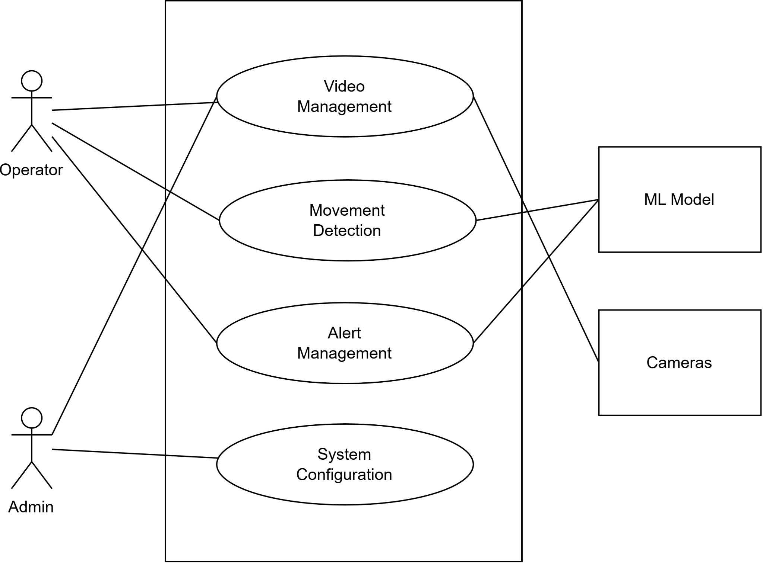
Scenario Based Modelling
Primary actors: Operator, Admin
Secondary actors: ML Model, Cameras
Goal in context: Module wise view of RapidEye
Use Case Level -1

Slide 8
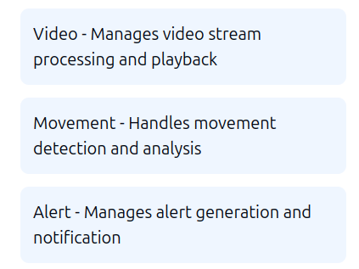
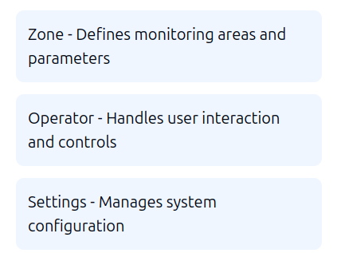
Class Based Modelling
Analysis Classes

Slide 9
Class Based Modelling
Analysis Classes - Key Class Relationships
Video interacts with Movement for detection
Movement triggers Alerts based on analysis
Zone defines areas for Movement monitoring
Operator manages Zones and receives Alerts
Settings configure behavior of all components

Slide 10
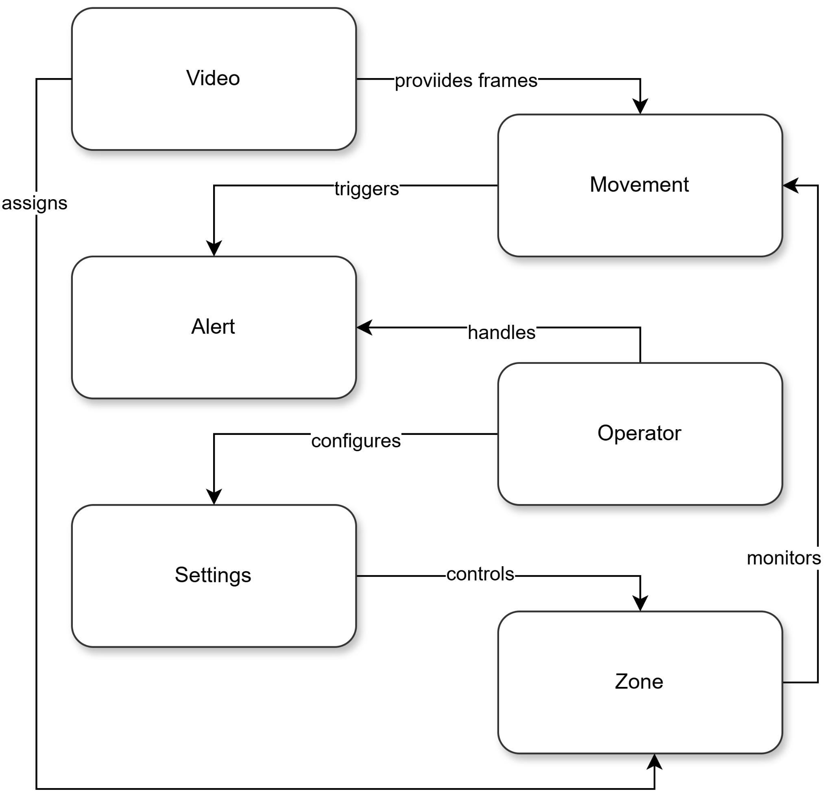
Class Based Modelling
Class Responsibility & Collaboration Diagram

Slide 11
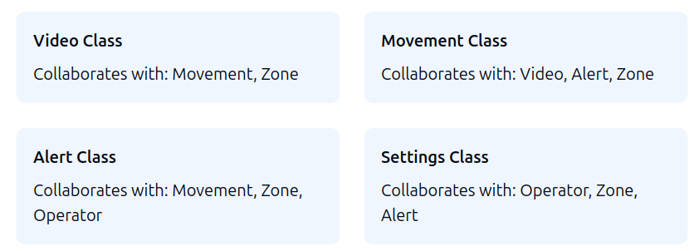
Class Based Modelling
Class Responsibility & Collaboration Diagram

Slide 12
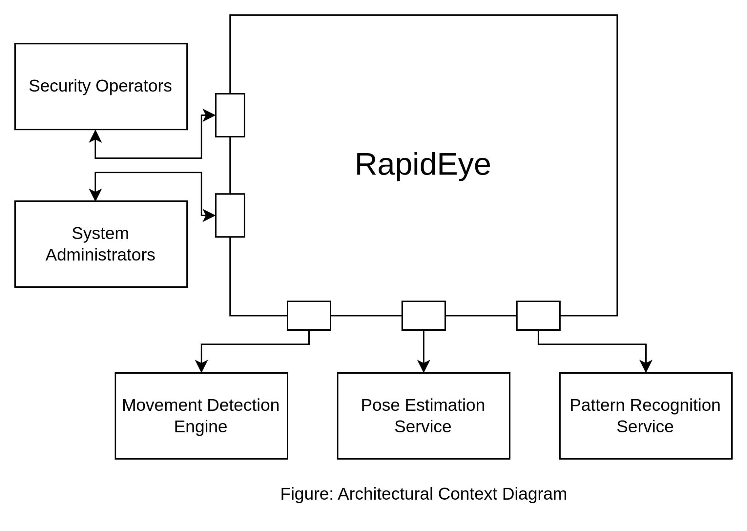
Architectural Context Diagram

Slide 13
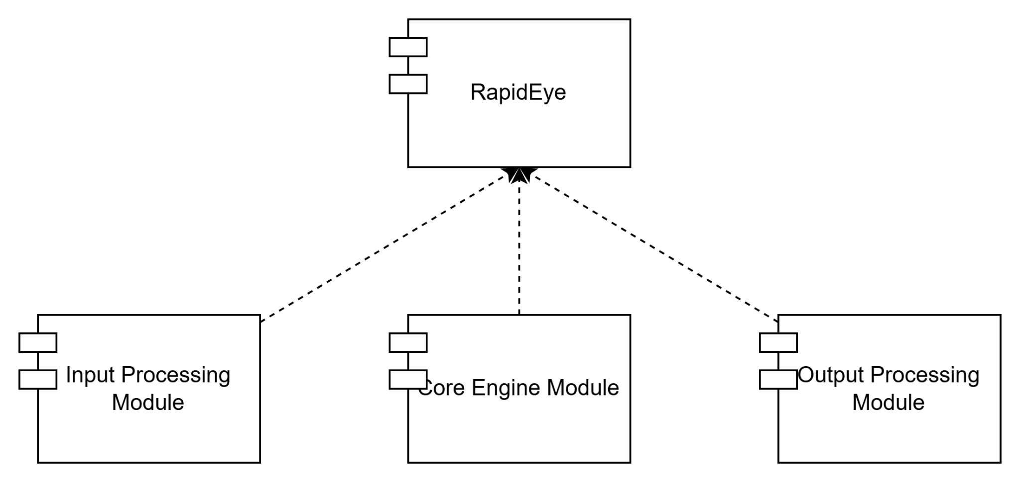
Top Level Components

Slide 14
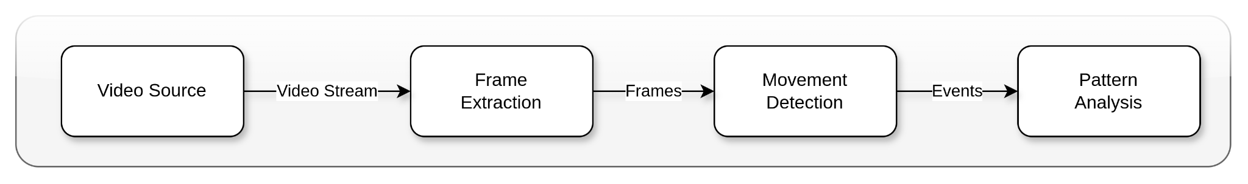
Patterns
Pattern: Pipe and Filter

Slide 15
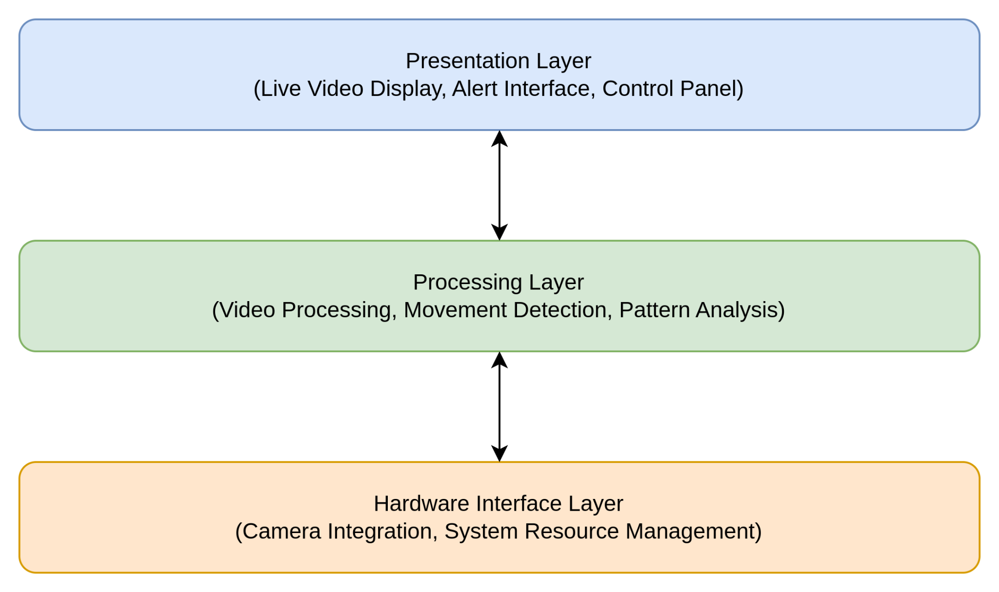
Patterns
Pattern: Layered Pattern

Slide 16
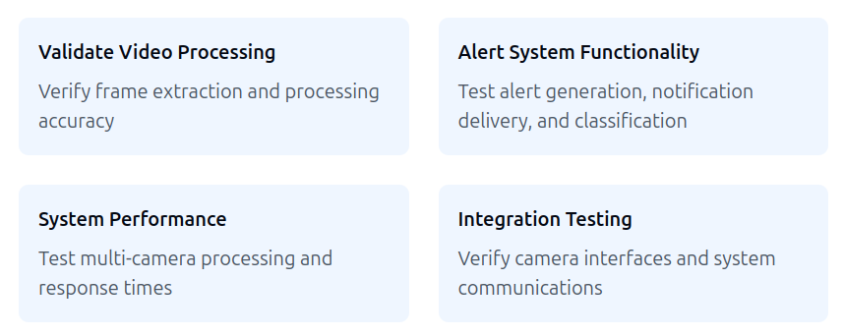
Preliminary Test Plan
The testing goals for this tool are:
To demonstrate that the system meets its requirements.
To verify that the dynamic logs are extracted accurately from executable files.
To validate the normalization functionality correctly.
To validate the tokenization functionality correctly
To ensure the Transformer-based architecture classifies executables accurately.
To test the detailed report generation for predictions.
To validate system performance with varying workloads.
To Validate the user experience

Slide 17
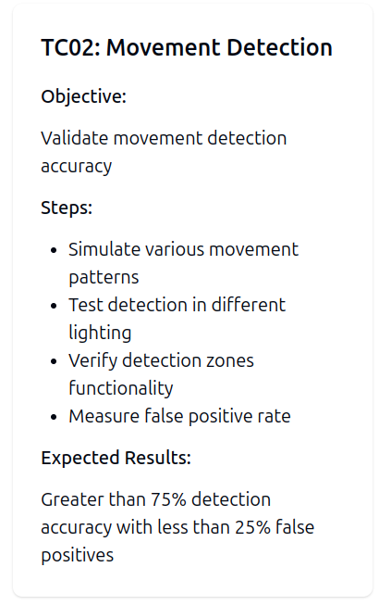
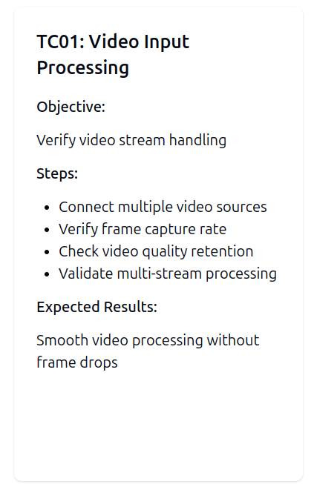
Example Test Case

Slide 18
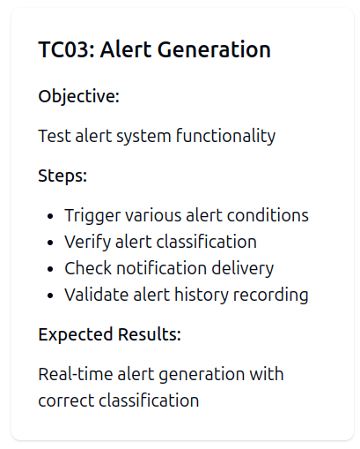
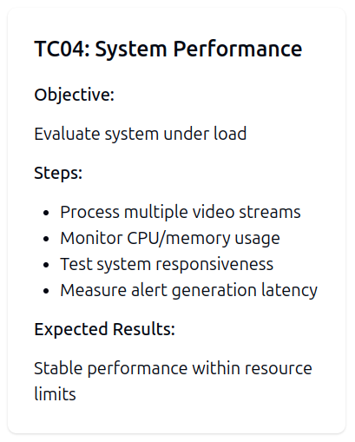
Example Test Case

Slide 19
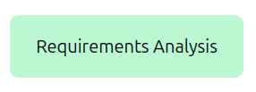
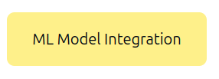

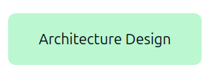
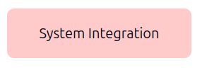
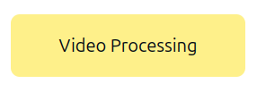
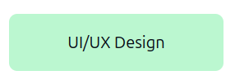

Work Progress
Done In Progress To Be Done

Slide 20
Future Work
ML Model Implementation
Alert System Development
Multi-Camera Integration
Performance Optimization
Testing and Validation
System Integration
Documentation
Deployment

Slide 21
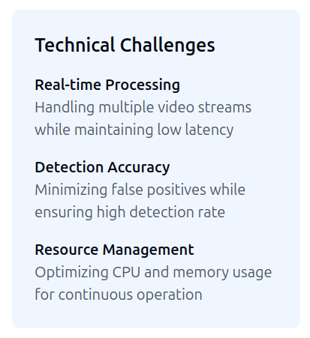
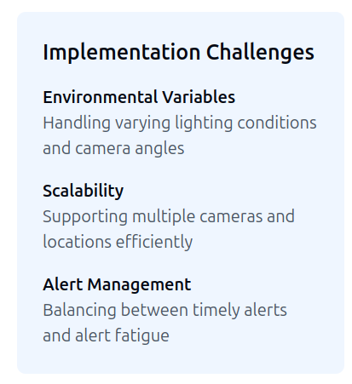
Challenges

Slide 22
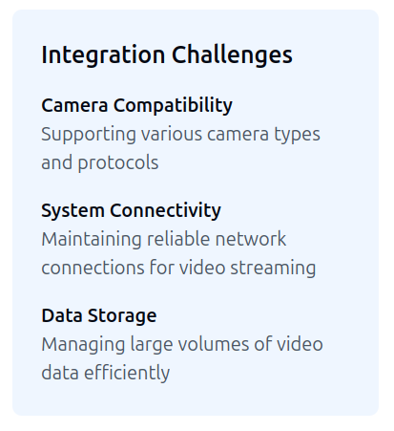
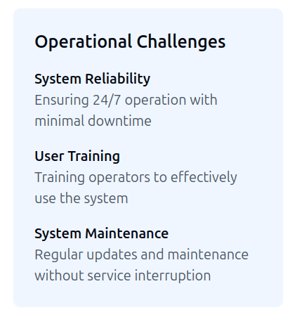
Challenges

Slide 23
Thank You

